Slide 1
BONE LOSS & PATTERN OF BONE LOSS
RUNGTA COLLEGE OF DENTAL SCIENCES AND RESEARCH,BHILAI
PRESENTED BY:
Dr Pushpendra Yadav
Sr. lecturer
Dept. of Periodontology

Slide 2
SPECIFIC LEARNING OBJECTIVES
CORE AREAS | DOMAIN | CATEGORY
Introduction | Affective | Desire to know
Causes of bone loss | Cognitive | Must to know
Factors determining bone morphology in periodontal disease | Cognitive | Must to know
Bone destruction patterns in Periodontal disease | Cognitive | Must to know

Slide 3
CONTENTS
PART-I
Introduction
Causes of bone loss
Bone destruction caused by Extension of gingival inflammation
Bone destruction caused by Trauma from occlusion
Bone destruction caused by Systemic disorders

Slide 4
CONTENTS
Factors determining bone morphology in periodontal disease
PART-II
Bone destruction patterns in Periodontal disease
Conclusion

Slide 5
PART-I

Slide 6
INRODUCTION
Changes that occur in bone are crucial because the destruction of bone is responsible for tooth loss.
The height and density of the alveolar bone are normally maintained by an equilibrium, regulated by local and systemic influences, between bone formation and bone resorption.
When resorption exceeds formation, both bone height and bone density may be reduced.

Slide 7
The level of bone is the consequence of past pathologic experiences, whereas changes in the soft tissue of the pocket wall reflect the present inflammatory condition.
Therefore, the degree of bone loss is not necessarily correlated with the depth of periodontal pockets, the severity of ulceration of the pocket wall, or the presence or absence of pus.

Slide 8
BONE LOSS CAUSED BY EXTENSION OF GINGIVAL INFLAMMATION

Slide 9
The most common cause of bone destruction in periodontal disease is the extension of inflammation from the marginal gingiva into the supporting periodontal tissues.
The inflammatory invasion of the bone surface and the initial bone loss that follows mark the transition from gingivitis to periodontitis.

Slide 10
Periodontitis is always preceded by gingivitis, but not all gingivitis progresses to periodontitis
the number of motile organisms and spirochetes increases
cellular composition of the infiltrated connective tissue also changes with increased severity.

Slide 11
PATHWAY OF SPREAD OF INFLAMMATION:
Gingival inflammation extends along the collagen fiber bundles and follows the course of the blood vessels through the loosely arranged tissues around them into the alveolar bone
Although the inflammatory infiltrate is concentrated in the marginal periodontium, the reaction is a much more diffuse one, often reaching the bone and eliciting a response before evidence of crestal resorption or loss of attachment exists

Slide 12
Interproximally,
Inflammation spreads to the loose connective tissue around the blood vessels, through the fibers, and then into the bone through vessel channels that perforate the crest of the interdental septum at the center of the crest , toward the side of the crest , or at the angle of the septum
Less frequently, the inflammation spreads from the gingiva directly into the periodontal ligament and from there into the interdental septum

Slide 13
Facially and lingually,
Inflammation from the gingiva spreads along the outer periosteal surface of the bone and penetrates into the marrow spaces through vessel channels in the outer cortex.

Slide 14
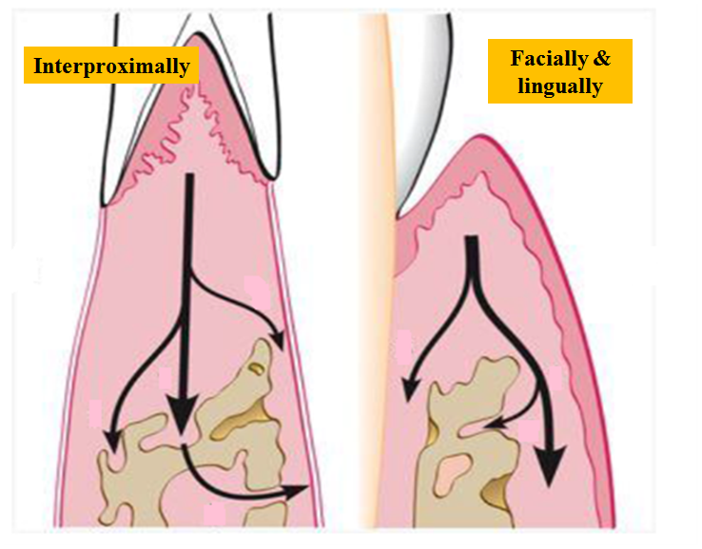

Slide 15
After inflammation reaches the bone by extension from the gingiva, …………….it spreads into the marrow spaces and replaces the marrow with a leukocytic and fluid exudate, new blood vessels, and proliferating fibroblasts.
Multinuclear osteoclasts and mononuclear phagocytes increase in number, and the bone surfaces appear, lined with Howship lacunae.

Slide 16
In the marrow spaces, resorption proceeds from within, causing a thinning of the surrounding bony trabeculae and enlargement of the marrow spaces, followed by destruction of the bone and a reduction in bone height.
Normally fatty bone marrow is partially or totally replaced by a fibrous type of marrow in the vicinity of the resorption

Slide 17
The amount of inflammatory infiltrate correlates with the degree of bone loss but not with the number of osteoclasts. However, the distance from the apical border of the inflammatory infiltrate to the alveolar bone crest correlates with both the number of osteoclasts on the alveolar crest and the total number of osteoclasts.

Slide 18
RADIUS OF ACTION
Locally produced bone resorption factors may need to be present in the proximity of the bone surface to exert their action.
A range of effectiveness is about 1.5 to 2.5 mm within which bacterial plaque can induce loss of bone. Beyond 2.5 mm there is no effect.

Slide 19
Interproximal angular defects can appear only in spaces that are wider than 2.5 mm because narrower spaces would be destroyed entirely.
Large defects greatly exceeding a distance of 2.5 mm from the tooth surface ( as in aggressive types of periodontitis) may be caused by the presence of bacteria in the tissues.

Slide 20
RATE OF BONE LOSS
Average rate of bone loss is about 0.2 mm a year for facial surfaces and about 0.3 mm a year for proximal surfaces when periodontal disease was allowed to progress untreated.
However, the rate of bone loss may vary, depending on the type of disease present

Slide 21
Loe et al. identified the following three subgroups of patients with periodontal disease based on interproximal loss of attachment and tooth mortality:
Approximately 8% of persons had rapid progression of periodontal disease, characterized by a yearly loss of attachment of 0.1 to 1.0 mm.

Slide 22
Approximately 81% of individuals had moderately progressive periodontal disease, with a yearly loss of attachment of 0.05 to 0.5 mm.
The remaining 11% of persons had minimal or no progression of destructive disease (0.05-0.09 mm yearly).
Loe, Anerud & Boysen 1978

Slide 23
PERIODS OF DESTRUCTION
Periodontal destruction occurs in an episodic, intermittent manner, with periods of inactivity or quiescence.
The reasons for the onset of destructive periods have not been totally determined, although the following theories have been given:
Bursts of destructive activity are associated with subgingival ulceration and an acute inflammatory reaction, resulting in rapid loss of alveolar bone.

Slide 24
Bursts of destructive activity coincide with the conversion of a predominantly T-lymphocyte lesion to one with a predominantly B-lymphocyte-plasma cell infiltrate.
Periods of exacerbation are associated with an increase of the loose, unattached, motile, gram-negative, anaerobic pocket flora, and periods of remission coincide with the formation of a dense, unattached, nonmotile, gram-positive flora with a tendency to mineralize.

Slide 25
Tissue invasion by one or several bacterial species is followed by an advanced local host defense that controls the attack

Slide 26
BONE FORMATION IN PERIODONTAL DISEASE
Areas of bone formation are also found immediately adjacent to sites of active bone resorption and along trabecular surfaces at a distance from the inflammation, in an apparent effort to reinforce the remaining bone (buttressing bone formation)
New bone formation impairs the rate of bone loss, compensating in some degree for the bone destroyed by inflammation.

Slide 27
These periods of remission and exacerbation (or inactivity and activity, respectively) appear to coincide with the quiescence or exacerbation of gingival inflammation, manifested by changes in the extent of bleeding, amount of exudate, and composition of bacterial plaque.

Slide 28
BONE DESTRUCTION CAUSED BY TRAUMA FROM OCCLUSION

Slide 29
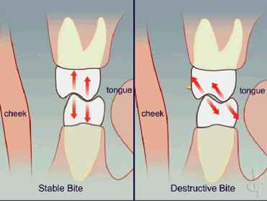
When occlusal forces exceed the adaptive capacity of the tissues, tissue injury results. The resultant injury is termed trauma from occlusion.
Carranza

Slide 30
Another cause of bone destruction in periodontal disease is trauma from occlusion, which can occur in the absence or presence of inflammation.

Slide 31
In the absence of inflammation, the changes caused by trauma from occlusion vary from…
increased compression and tension of the periodontal ligament and increased osteoclasis of alveolar bone to necrosis of the periodontal ligament and bone and the resorption of bone and tooth structure.
These changes are reversible in that they can be repaired if the offending forces are removed.

Slide 32
However, persistent trauma from occlusion results in funnel-shaped widening of the crestal portion of the periodontal ligament with resorption of the adjacent bone.
These changes, which may cause the bony crest to have an angular shape, represent adaptation of the periodontal tissues aimed at “cushioning” increased occlusal forces; however, the modified bone shape may weaken tooth support and cause tooth mobility.

Slide 33
When it is combined with inflammation, trauma from occlusion aggravates the bone destruction caused by the inflammation and results in bizarre bone patterns

Slide 34
BONE DESTRUCTION CAUSED BY
SYSTEMIC DISORDERS

Slide 35
This systemic influence on the response of alveolar bone, as envisioned by Glickman during the early 1950s, considers a systemic regulatory influence in all cases of periodontal disease.
In addition to the virulence of plaque bacteria, the nature of the systemic component rather than its presence or absence influences the severity of the periodontal destruction. This was called the BONE FACTOR CONCEPT

Slide 36
Osteoporosis is a physiologic condition of postmenopausal women that results in the loss of bone mineral content as well as structural bone changes.
Periodontitis and osteoporosis share a number of risk factors (e.g., aging, smoking, certain diseases, medications that interfere with healing).
Some studies show a relationship between skeletal density and oral bone density; between crestal height and residual ridge resorption; and between osteopenia and periodontitis, tooth mobility, and tooth loss

Slide 37
Periodontal bone loss may also occur with generalized skeletal disturbances (e.g., hyperparathyroidism, leukemia, histiocytosis X) via mechanisms that may be totally unrelated to the usual periodontal problem.

Slide 38
FACTORS DETERMINING BONE MORPHOLOGY

Slide 39
Various factors are:
Normal variation in alveolar bone
Exostoses
Trauma from occlusion
Buttressing bone formation (lipping)
Food impaction
Aggressive periodontitis

Slide 40
Normal Variation in Alveolar Bone
Considerable normal variation exists in the morphologic features of alveolar bone, which affects the osseous contours produced by periodontal disease.

Slide 41
The anatomic features that substantially affect the bone-destructive pattern in periodontal disease include the following:
The thickness, width, and crestal angulation of the interdental septa
The thickness of the facial and lingual alveolar plates
The presence of fenestrations and dehiscences
The alignment of the teeth
Root and root trunk anatomy
Root position within the alveolar process
Proximity with another tooth surface

Slide 42
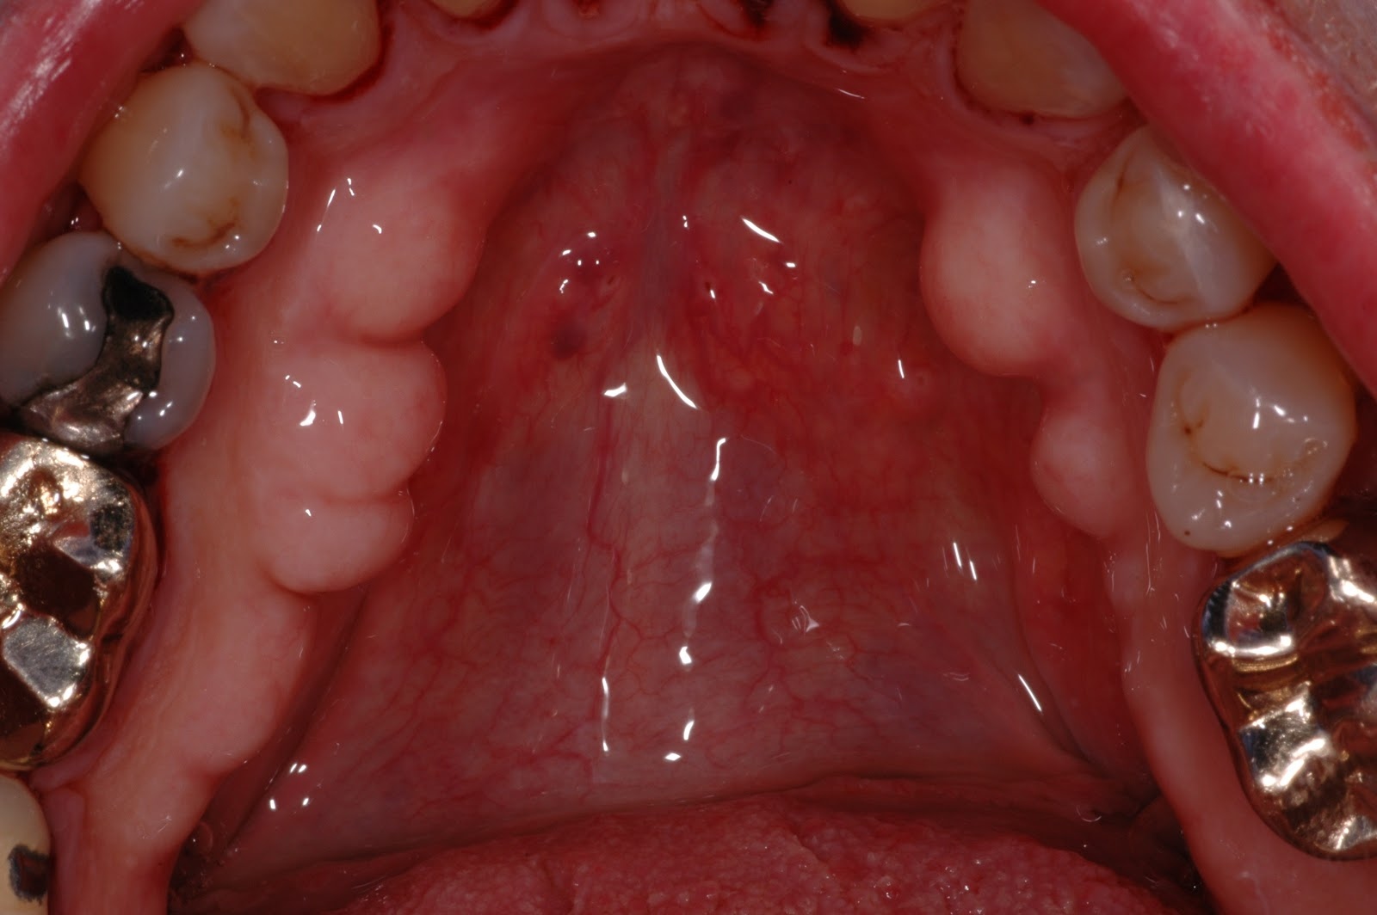
Exostoses
Exostoses are outgrowths of bone of varied size and shape. Palatal exostoses have been found in 40% of human skulls.
They can occur as small nodules, large nodules, sharp ridges, spike-like projections, or any combination of these.

Slide 43
Trauma from Occlusion
Trauma from occlusion may be a factor in determining the dimension and shape of bone deformities.
It may cause a thickening of the cervical margin of alveolar bone or a change in the morphology of the bone (e.g., angular defects, buttressing bone) on which inflammatory changes will later be superimposed.

Slide 44
Buttressing Bone Formation (Lipping)
Bone formation sometimes occurs in an attempt to buttress bony trabeculae weakened by resorption.
When it occurs within the jaw, it is termed central buttressing bone formation. When it occurs on the external surface, it is referred to as peripheral buttressing bone formation.
The latter may cause bulging of the bone contour, termed lipping, which sometimes accompanies the production of osseous craters and angular defects

Slide 45
Food Impaction
Interdental bone defects often occur where proximal contact is abnormal or absent.
Pressure and irritation from food impaction contribute to the inverted bone architecture.
In some cases the poor proximal relationship may result from a shift in tooth position because of extensive bone destruction preceding food impaction. In such patients, food impaction is a complicating factor rather than the cause of the bone defect

Slide 46
Aggressive Periodontitis
A vertical or angular pattern of alveolar bone destruction is found around the first molars in aggressive periodontitis
Two types: Localized aggressive periodontitis (LAP)
Generalized aggressive periodontitis (GAP)

Slide 47
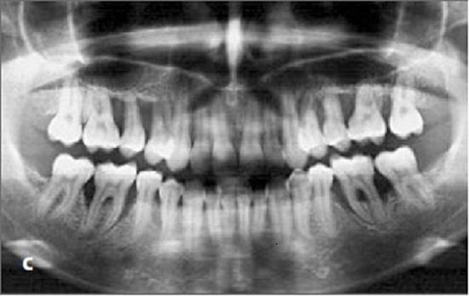

Slide 48
BONE DESTRUCTION PATTERN IN PERIODONTAL DISEASE
PART-II

Slide 49
Horizontal bone loss
Vertical bone loss
Osseous craters
Bulbous bony contours
Reversed architecture
Ledges
Furcation involvement

Slide 50
HORIZONTAL BONE LOSS
Most common pattern
Bone height is reduced but bone margin remain perpendicular to the teeth surface
The interdental septa and facial and lingual plates are affected, but not necessarily to an equal degree around the same tooth

Slide 51
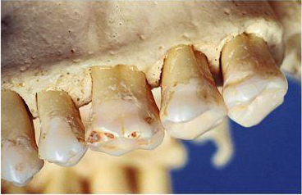

Slide 52
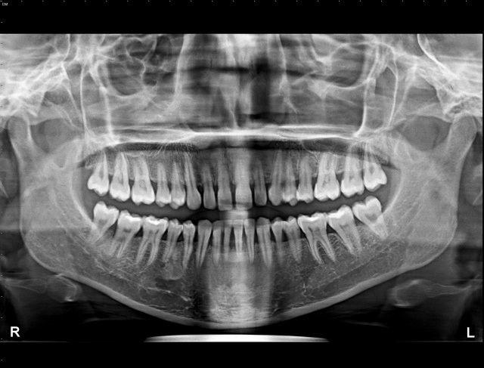

Slide 53
VERTICAL BONE LOSS
‘‘Periodontal defect within the bone surrounded by one, two or three bony walls or a combination thereof’
Vertical or angular defects occur in an oblique direction, leaving a hollowed-out trough in the bone alongside the root
The base of the defect is located apical to the surrounding bone

Slide 54
Classification: Goldman & Cohen 1958
One-wall intrabony defects: defects limited by one osseous wall and the tooth surface
Two-wall intrabony defects: defects limited by two osseous walls and the tooth surface
Three-wall intrabony defects: defects limited by three osseous walls and the tooth surface

Slide 55
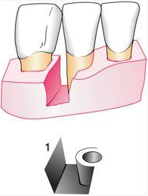
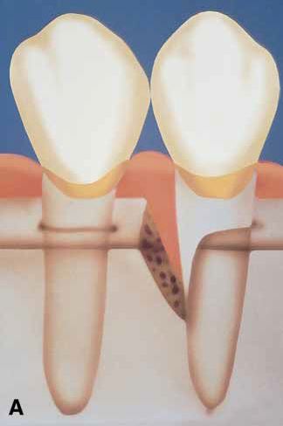
One wall defect / Hemiseptum: only one wall is present

Slide 56
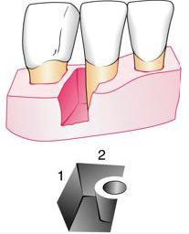
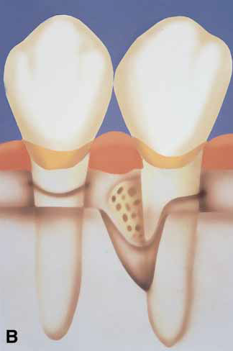
Two wall defect: Two wall is present

Slide 57
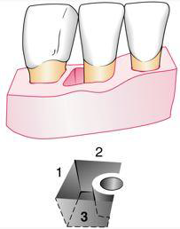
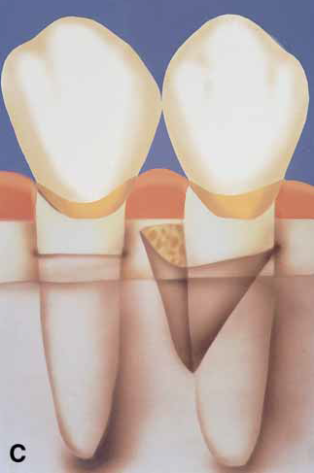
Three wall defect: three walls is present. Common on the mesial surface of molars

Slide 58
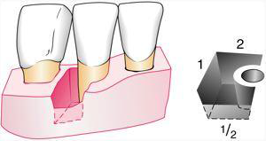
Combined defect: Intrabony defects presenting a complex anatomy consisting of a three-wall component in the most apical portion of the defect, and two- and/or one-wall components in the more superficial portions

Slide 59
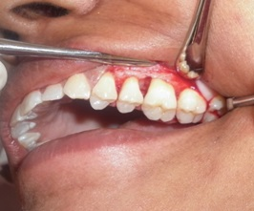

Slide 60
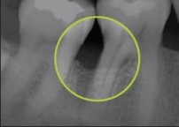
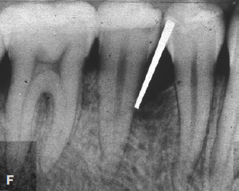
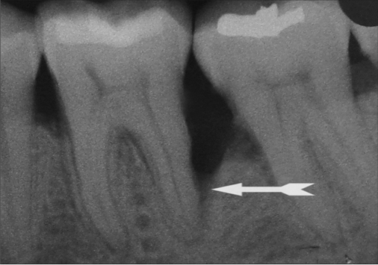

Slide 61
OSSEOUS CRATERS
It is defined as a cup- or bowl shaped defect in the interdental alveolar bone with bone loss nearly equal on the roots of two contiguous teeth and more coronal position of the buccal and lingual alveolar crest
Glossary of periodontal terms (AAP 1993)
The facial and lingual/palatal walls may be of unequal height

Slide 62
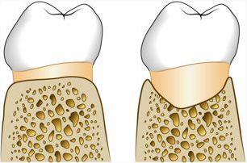

Slide 63
Osseous craters are concavities in the crest of the interdental bone confined within the facial and lingual walls
One third (35.2%) of all defects and about two thirds (62%) of all mandibular defects
occur twice as often in posterior segments as in anterior segments

Slide 64
Reasons for high frequency of craters:
The interdental area collects plaque and is difficult to clean
The normal flat or even concave faciolingual shape of the interdental septum in lower molars may favor crater formation
Vascular patterns from the gingiva to the centre of the crest may provide a pathway for inflammation

Slide 65
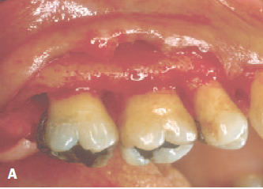

Slide 66
BULBOUS BONY CONTOURS
Bulbous bone contours are bony enlargements caused by exostoses, adaptation to function, or buttressing bone formation
They are found more frequently in the maxilla than in the mandible.

Slide 67
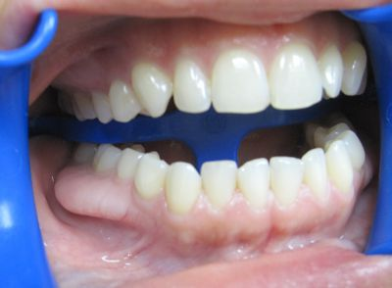

Slide 68
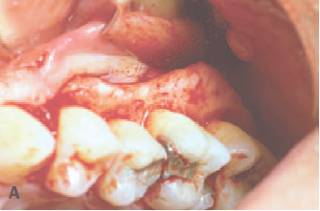

Slide 69
REVERSE ARCHITECTURE
Produced by loss of interdental bone, including the facial plates and lingual plates
The interradicular bone is more coronal as compared to interdental bone while the reverse is ideal condition
Common in the maxilla

Slide 70
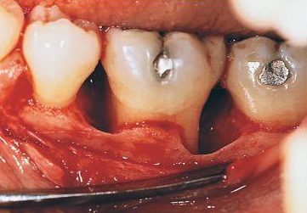

Slide 71
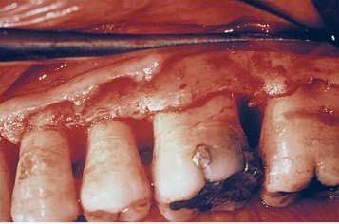
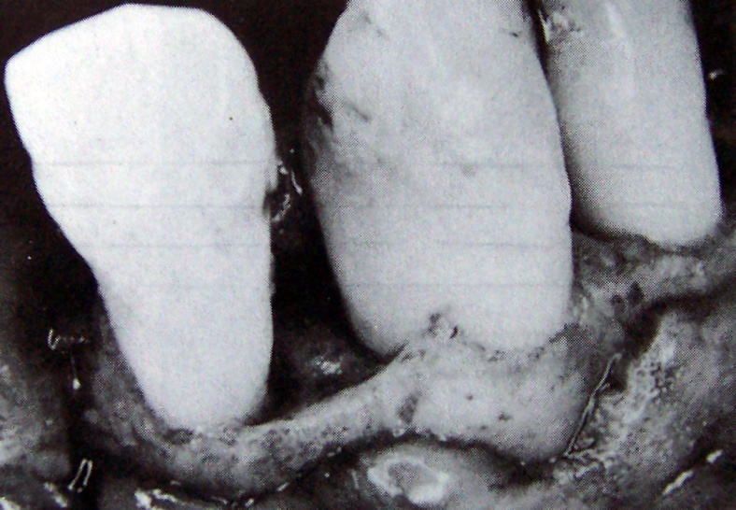
LEDGES
Ledges are plateau-like bone margins caused by resorption of thickened bony plates

Slide 72
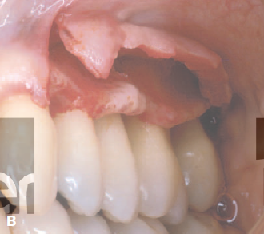

Slide 73
FURCATION INVOLVEMENT
The term furcation involvement refers to the invasion of the bifurcation and trifurcation of multirooted teeth by periodontal disease

Slide 74
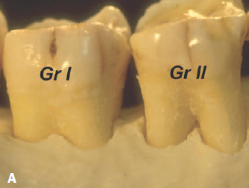
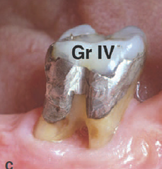
GLICKMANN’S CLASSIFICATION:

Slide 75
Microscopically, furcation involvement presents no unique pathologic features.
It is simply a phase in the rootward extension of the periodontal pocket.
In its early stages, a widening of the periodontal space occurs, with cellular and fluid inflammatory exudation, followed by epithelial proliferation into the furcation area from an adjoining periodontal pocket.

Slide 76
Extension of the inflammation into the bone leads to resorption and reduction in bone height.
The bone-destructive pattern may produce horizontal loss, or angular osseous defects associated with intrabony pockets may exist.
Plaque, calculus, and bacterial debris occupy the denuded furcation space.

Slide 77
The role of trauma from occlusion in the etiology of furcation lesions is controversial.
Some assign a key role to trauma, believing that furcation areas are most sensitive to injury from excessive occlusal forces.
Others deny the initiating effect of trauma and consider that inflammation and edema caused by plaque in the furcation area tend to extrude the tooth, which then becomes traumatized and sensitive.

Slide 78
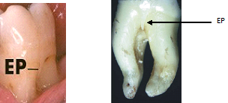
Other factors that may play a role are the presence of enamel projections into the furcation
The presence of accessory pulpal canals in the furcation area may extend pulpal inflammation to the furcation

Slide 79
SUMMARY

Slide 80
Periodontal osseous defects are a frequent sequela of periodontitis.
Diagnosing their presence and establishing their morphology before surgical access requires a careful clinical examination combined with diagnostic quality radiographs.

Slide 81
REFERENCE
Newman MG, Takei HH, Klokkevold PR, Carranza FA. Carranza’s clinical periodontology, 10th ed. Saunders Elsevier; 2007.
Lindhe J, Lang NP and Karring T. Clinical Periodontology and Implant Dentistry. 6th ed. Oxford (UK): Blackwell Publishing Ltd.; 2015.
Newman MG, Takei HH, Klokkevold PR, Carranza FA. Carranza’s clinical periodontology, 13th ed. Saunders Elsevier; 2018.

Slide 82
THANK YOU

